Slide 1
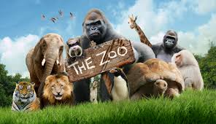
Submit:
LIOR MALUL ID:209305226
RON GOLAN ID:211494711

Slide 2

Description of the program
This project, developed by Lior, is an Object-Oriented programming focused on building a zoo management system in Java.
Key Components:
Zoo Management: The system starts with a pre-set collection of animals and an initial budget. Zoo managers can perform various tasks such as viewing zoo details (animals and financial status), purchasing new animals, removing animals from the zoo, feeding the animals, sorting and displaying them, and managing yearly progress. This includes updating happiness levels, aging the animals, and removing those that exceed their lifespan
Animals (entitys)
The animals in the zoo have attributes such as name, age, and height. Each animal also has a happiness scale that changes based on different actions. Additionally, every animal makes a distinct sound. The animals are divided into categories, such as Fish and Predators.

Slide 3

SO WHY DATABASE?
The system requires a database for several key reasons:
Data Persistence:
A database allows the system to persistently store information about the zoo, even after shutdown. For example, when adding new animals or updating their ages, the changes are saved permanently
Querying:
Will allow you to search the stored data with more complex queries such as: find the height penguin, or a list or all the predators in the zoo.
Scalability:
Will be able to handle large data sets efficiently.
Backup and recovery:
Will be able to recover data if system breaks down in other name its reliability.

Slide 4

User: the user in the system will be the Zoo Manager, as it was writing above, he will be able to add a animal or remove, feed the animals, sort, hear animals, and do the progress a year operation.

Slide 5





ENTITIES

Slide 6
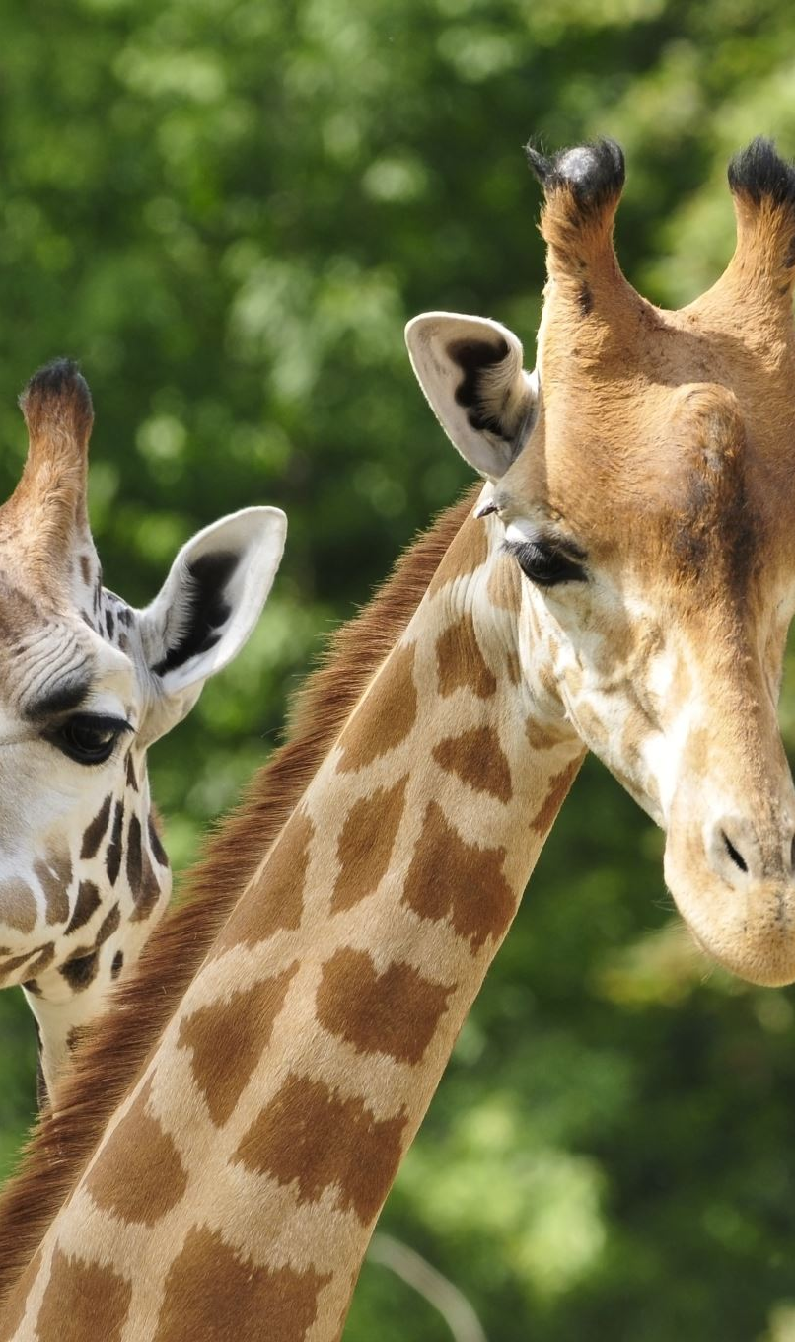
Zoo
attributes:
name: name of the zoo.
Address: physical address of the zoo.
Animals: A collection of animals present in the zoo
Behavior:
Manage the addition, and removal of the animals
Track and display the animals in the zoo
Progress year operation, and feeding the animals

Slide 7
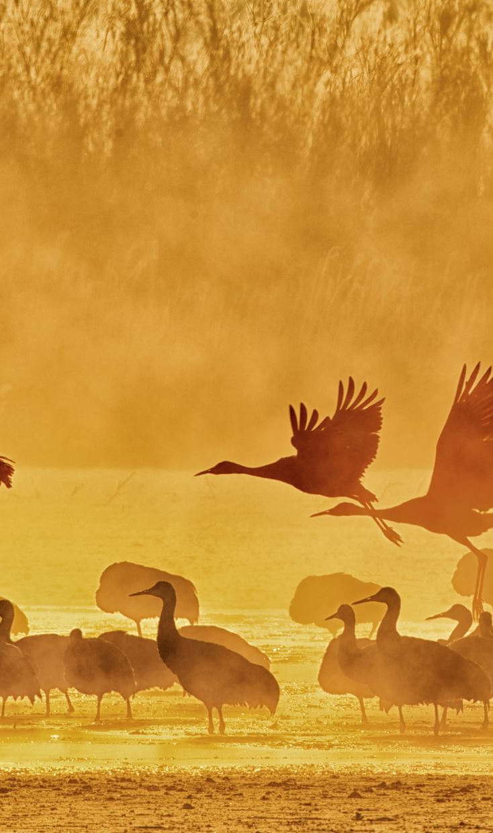
Animal (Base Entity):
Attributes:
Id: unique id for each animal(primary key)
name: the name of the animal.
age: the age of the animals in years.
Height: the height of the animal in centimeters.
happiness: number the representing how happy the animal is form a scall of 0 to 100.
Functions:
Set and get basic functions (id, name, age, height, happiness (will have others get and set based on their kind)).
AgeOneYear: increases the age of an animal.

Slide 8
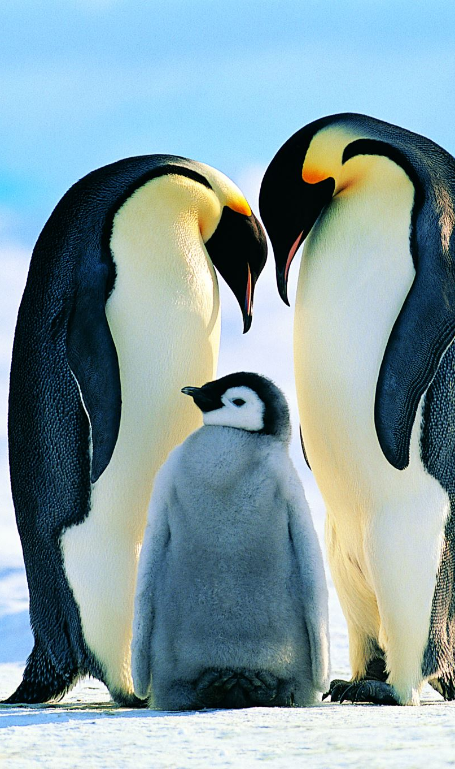
Penguin (Subclass of animal)
Attributes:
Animal attributes: ID (Key), name, age, height, happiness.
Lifespan = 6.
Functions:
Feed: the food that needs per day (1 fish).
makeNoise: the noise the penguin make (squack).

Slide 9
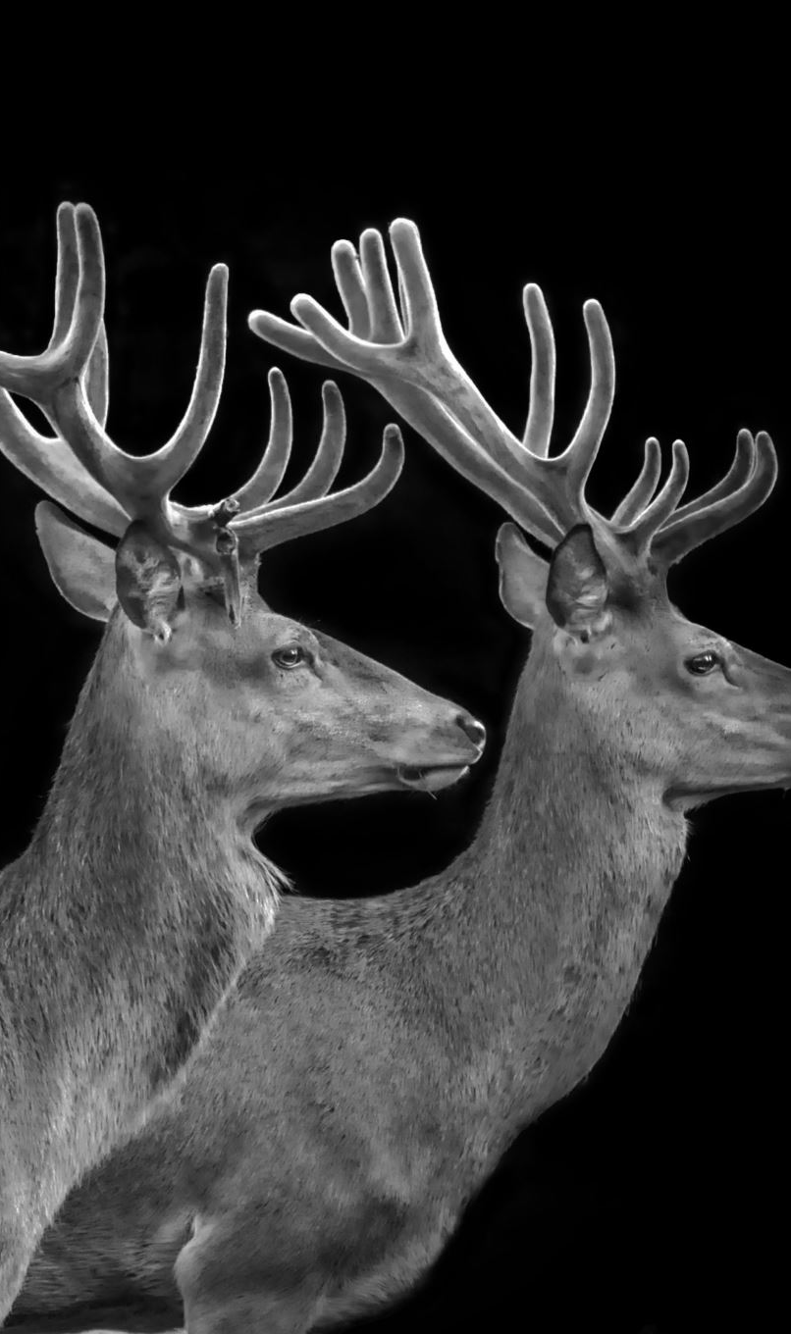
Cervus (Subclass of animal)
Attributes:
Animal attributes: ID (Key), name, age, happiness
Gender: the gender of the Cervus
lengthOfTheRays: the length of rays that the Cervus has.
Lifespan = 10
Functions:
Get, Set: get and sets the length of the rays.
Get Gender: (gender cant be set) gets the gender of the cevus.
Feed: the food that needs per day (age times meat).
makeNoise: the noise the cevus make (OhOhOh).

Slide 10
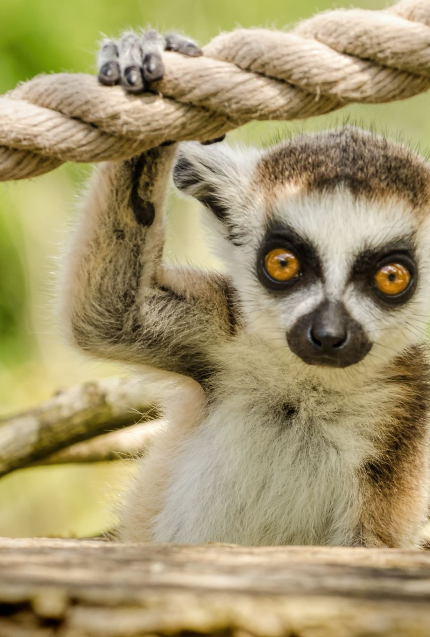
Lemur (Subclass of animal)
Attributes:
Animal attributes: ID (Key), name, age, height, happiness
Lifespan = 15
Functions
Feed: the food that needs per day (4 fish)
makeNoise: the noise the penguin make (I like to move it).

Slide 11
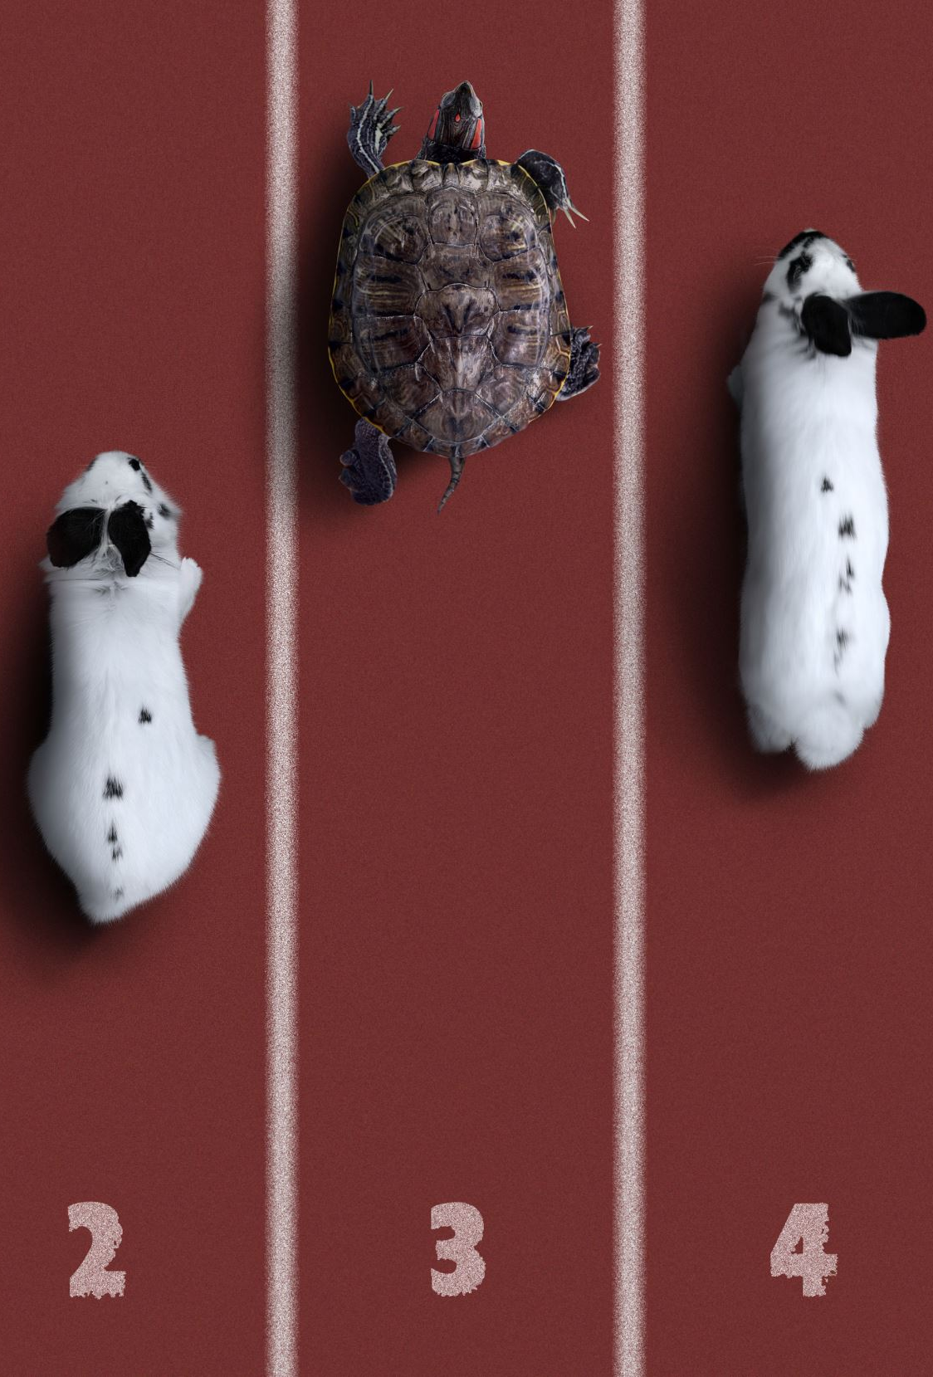
Carnivore (Subclass of animal)
Attributes:
Animal attributes: ID (Key), name, age, happiness
Gender: the gender of the Carnivore
Lifespan = 15
Functions:
No functions (but get, and set).

Slide 12
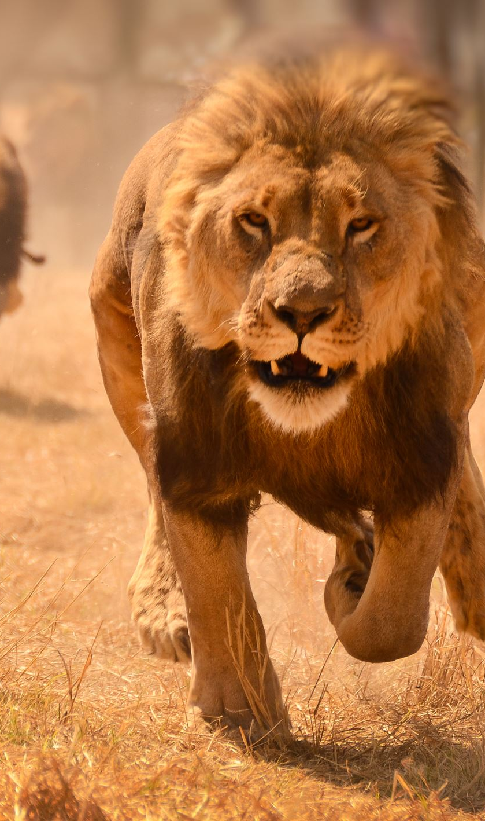
Lion (Subclass of Carnivore)
Attributes:
Carnivore attributes: ID (Key), name, age, happiness, gender.
Functions:
Feed: the food that needs per day (base on weight and age).
makeNoise: the noise the Lion make (ROAR).

Slide 13
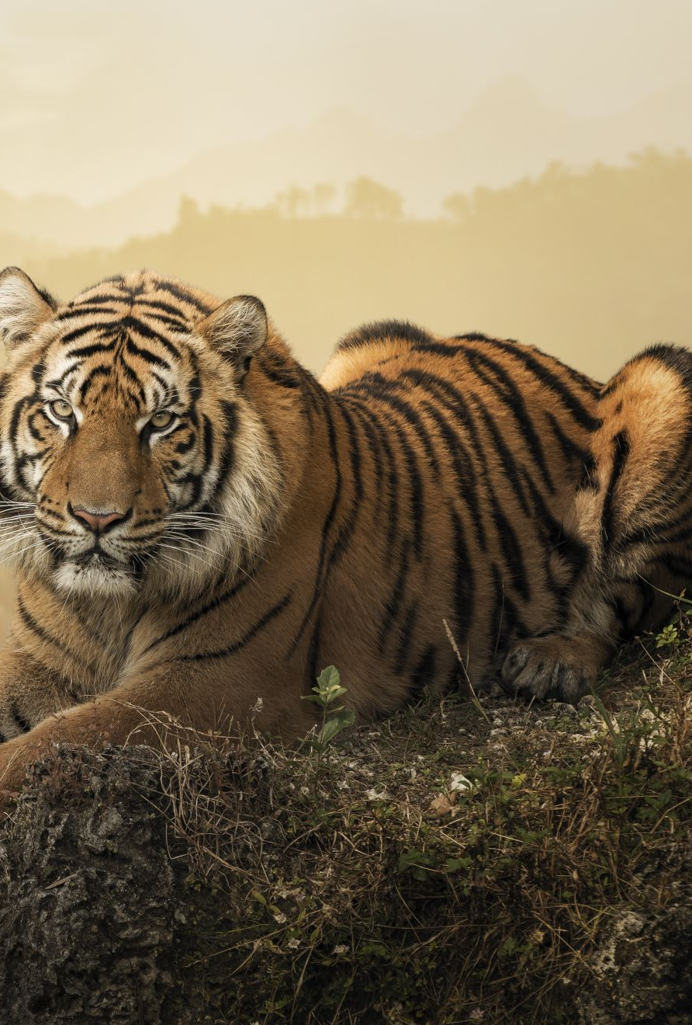
Tiger (Subclass of Carnivore)
Attributes:
Carnivore attributes: ID (Key), name, age, happiness, gender.
Functions:
Feed: the food that needs per day (base on weight and age).
makeNoise: the noise the Tiger make (roar).

Slide 14
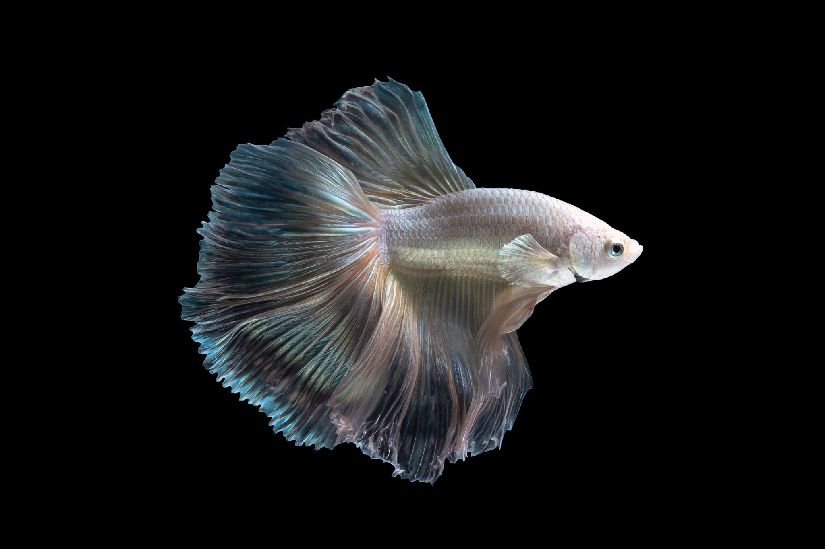
Fish (Subclass of animal)
Attributes:
Animal attributes: ID (Key), age, happiness.
hisColor: color of the fish, can be many.
characteristicOfAFisg: skin characteristic.
Functions:
makeNoise: make noise of fish (bolb).
FeedFish: the food that a fish needs per day (base on lenght).

Slide 15
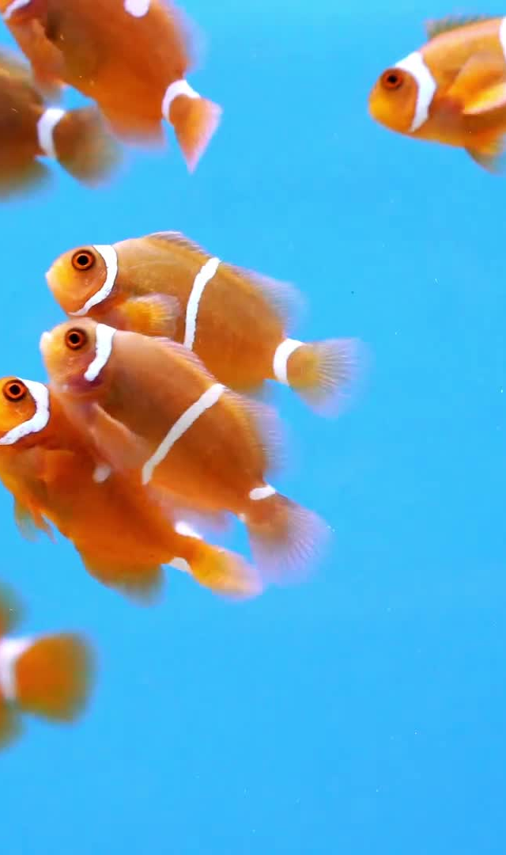
GoldFish, ClownFish, AquatiumFish (Subclass of fish)
Attributes:
Fish attributes: ID (Key), age, lengh, happiness, color, characteristic.
Lifespan = 8-25
Functions:
Same as fish: feed, makeNoise.

Slide 16
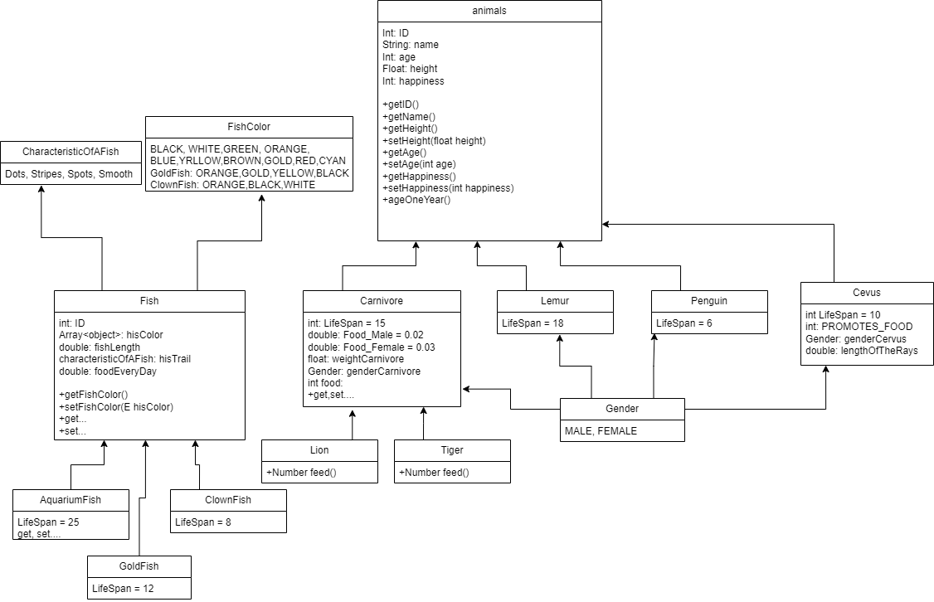
UML

Slide 17
Now for the database part!
What we did in the database?
We created 11 tables to structure the zoo's data.
Animals (ID, Age, Happiness): This is the main table, with the primary key being ID. It includes Age and Happiness attributes, which are relevant to all animals without exception.
AnimalsName (ID, Name): Fish do not have names in this system, so we created a separate table to store names for other animals.
Gender (ID, Gender): Some animals, like penguins, fish, and lemurs, do not have a defined gender in the main program. Therefore, we created a separate table to store the gender information for those animals.
The other 8 tables will be detailed in the next pages

Slide 18
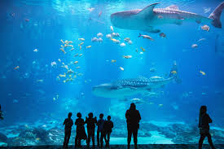
fish
After careful consideration, we decided not to create a single main table for all the fish. The reasons are as follows:
Not all fish have changeable colors. For example, the colors of clownfish and goldfish are constant, so there is no need to store their color in a table.
As taught in class, separating tables helps save space and makes the database more efficient.
As a result, we decided to create separate tables for each type of fish:
Aquarium Fish(ID, Length, Color, Trait),
Clownfish(ID, Length),
Goldfish(Length, Color)

Slide 19
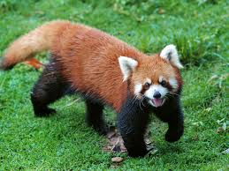
Other animals
The following animals also have their own individual tables for the same reason - to save space in the database.
Cervus(ID, RayLength)
Lemur(ID, Height)
Penguin(ID, Height)
Lion(ID, Weight)
Tiger(ID, Weight)
In total, this bring us to 11 tables

Slide 20

Create
First, the database script will be provided with the code. You will need to insert it into your own PostgreSQL database. The script will include, CREAT TABLE statements. The first table will be the animal table which will contain the ID as PRIMARY KEY All other tables will reference this ID ensuring that when an entry is deleted from the animals table it is also removed from all related tables.
Once all the tables are created, we will set up a sequence that starts at 1,000. This sequence will automatically generate unique ID’s for the animals, ensuring that no two animals have the same ID. A function will be set as the default to enforce this uniqueness.

Slide 21

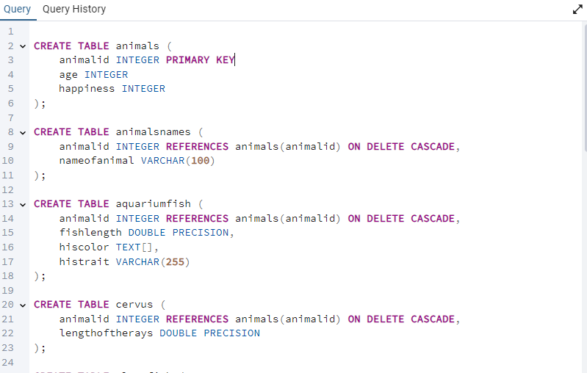




Slide 22

SELECT
When the program starts, it will use the SELECT function to collect all the data from the database, display it, and load the data into the program.
For example, let's take the penguin.

Slide 23
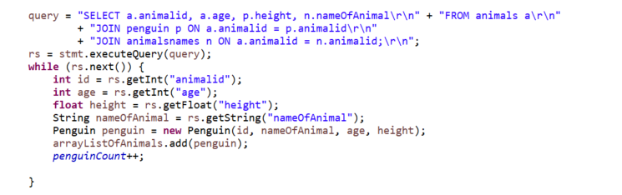

Slide 24

INSERT
The INSERT statement in the code will be used when adding a new animal. We will add the animal using a string that will be passed to the database. For example, to insert a Cervus;
First, we generate an ID using the sequence function we discussed earlier. Then, we assign this ID a name and a gender.
Next, we noticed that the attributes for Cervus are similar to those of tiger and lion variables, where instead of double weight, it has double raysLenght. So use the createCervusOrCarnivore and insert the ray length as well.

Slide 25
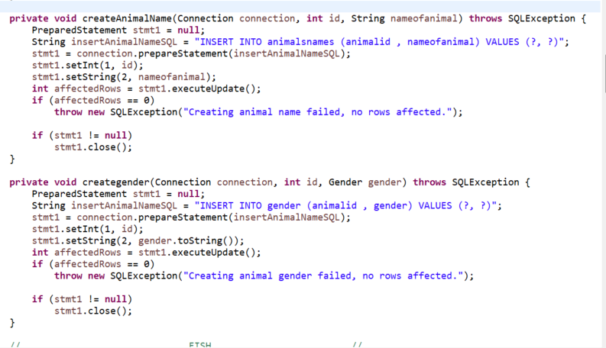

Slide 26
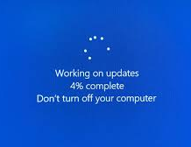
UPDATE
As originally designed, the program includes a function called a year has pass, which simulates all the animals aging by one year. In this function, we use the UPDATE statement to modify the database, updating the age of and happiness for each animal accordingly.

Slide 27
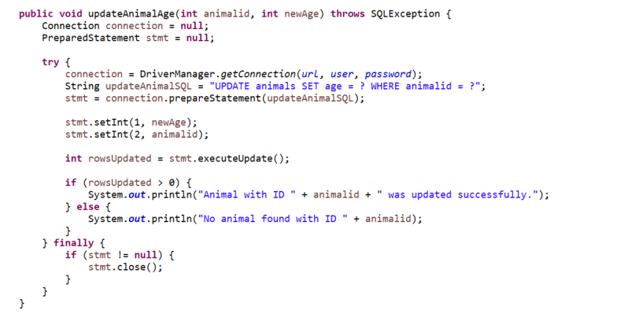

Slide 28
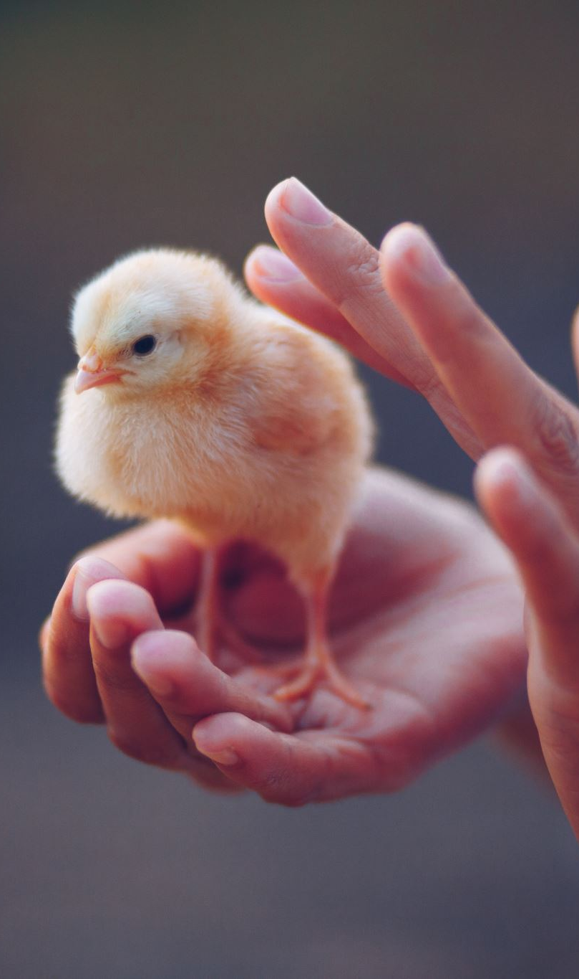
DELETE
The DELETE function is used when an animal reaches its lifespan or when its happiness drops to 0. In either case, the animal is removed from both the program and the database. The checks for age and happiness are performed within the program, and then the animal is deleted from both.
Additionally, we added a function to delete all animals from the zoo, ensuring they are removed from both the program and the database.

Slide 29
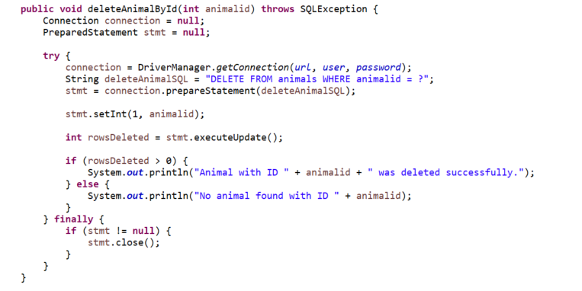

Slide 30
New database
Because we got another week to present the project we added some now databases:
Money – a new table that only have one row that will have the manger money, whenever his money will change in the program the money in the database will change as well.
Animals price – a table that if we will have all the prices of the animals, so if we will want to change the animal prices in the future we can add a task to the menu that will change the animal price

Slide 31
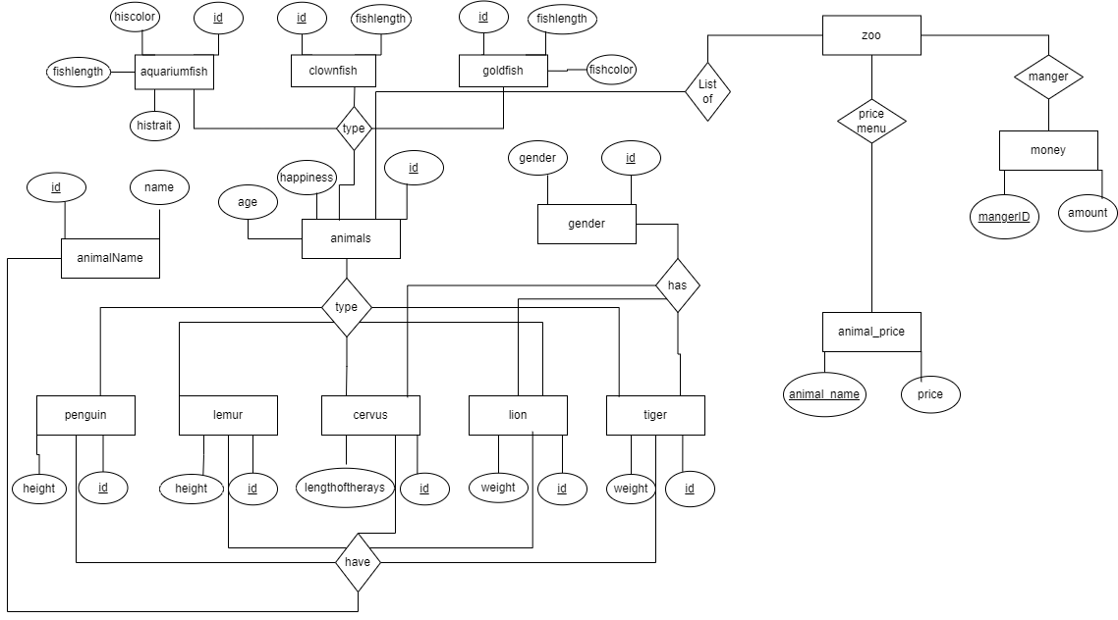
ERD

